Slide 1

Prosper loan analysis
Presentation of Key Findings
By: Hayden Allison, 10/15/2023

Slide 2
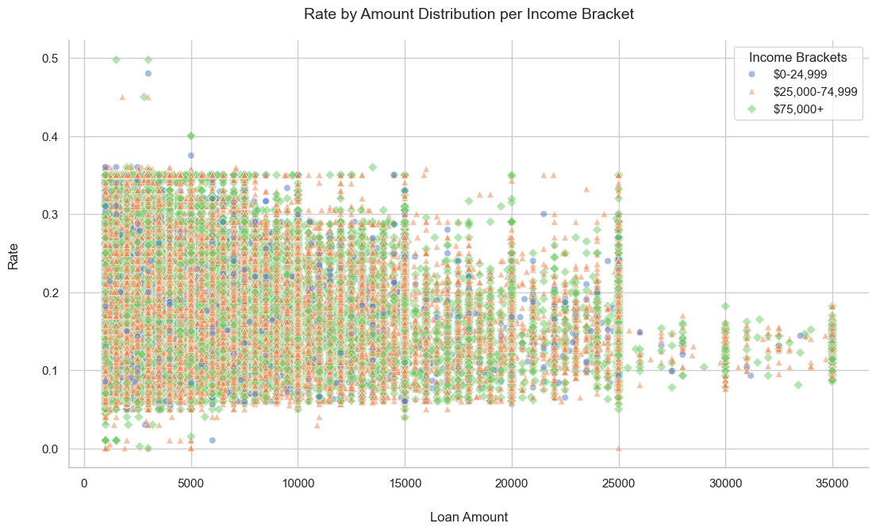
Rate by Loan Amount Distribution per Income Bracket
The distribution of loan amounts and rates is mixed across income brackets.
Limit access to higher loan amounts, especially for customers in the $0-24,999 income bracket, to ensure loan repayment.
Poverty line for individual in USA: $15,000. Bracket $0-24,999 should be limited to $20,000.
Prosper is accommodating their higher loan borrowers properly with lower rates.

Slide 3
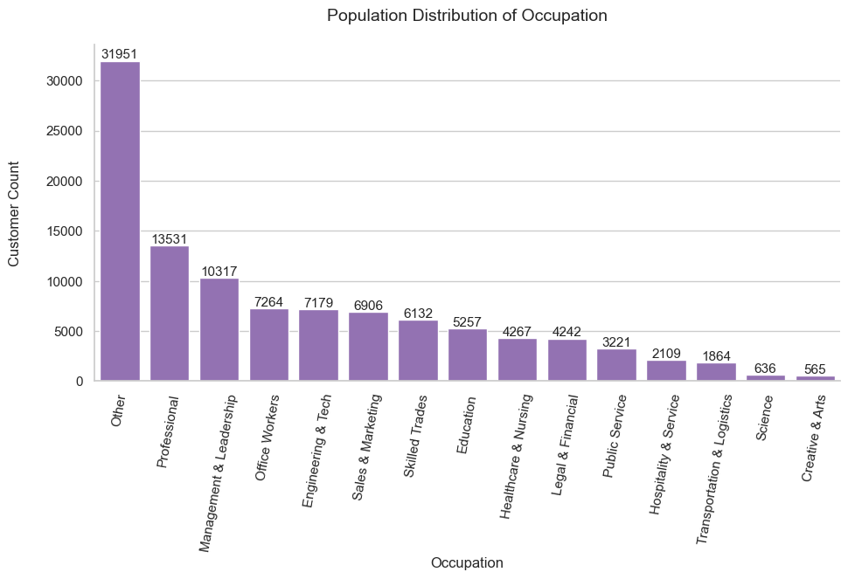
Populace Distribution of Occupation
Consider targeted marketing attempts to lowly populated groups for easy growth unless there's an absence of workers available is discovered.
Proven effective approach is targeting Professional to Legal & Financial categories, not including Skilled Trades (contains professions where workers are dispersed or constantly changing locations).
Word spreads easily since employees are within proximity, in other words free advertising.

Slide 4
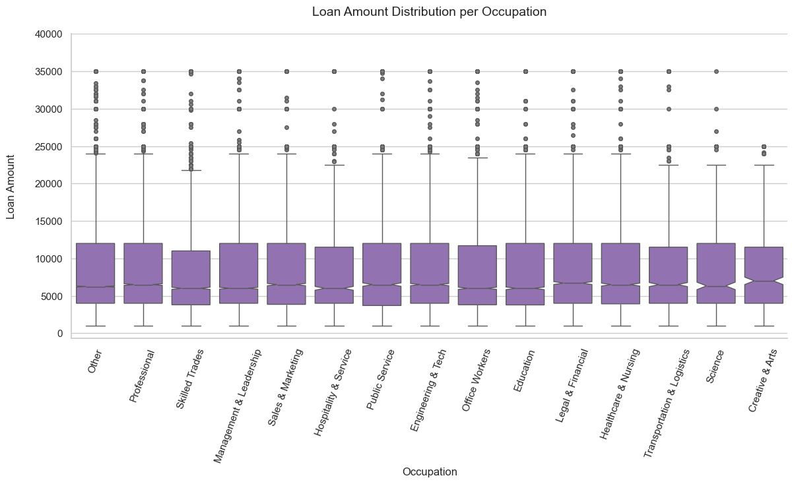
Loan Amount by Occupation
Creative & Arts has the strictest range for loan amounts, while other occupations tend to have more flexibility.
Focus marketing efforts on occupations that borrow larger loans, such as members of Professional occupation.
Target the occupations who borrower financially bigger loans to maximize profits. Marketing to Creative & Arts will yield less revenue compared to Professional for example.

Slide 5
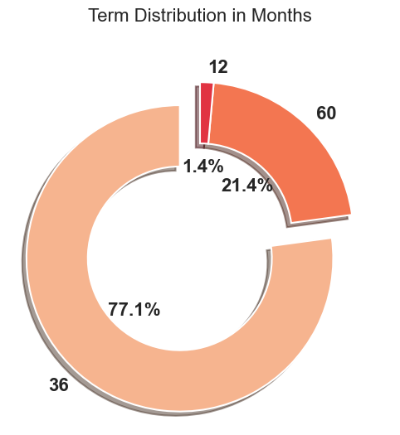
Term Distribution in Months
Focus on promoting the terms customers are interested in and support these promotions with deals, enticing conditions, etc.
Increasing 12-month loan terms to 18 or 24 should be explored to increase their popularity which can in turn supply new customers. 12-month loan term is not even considered by people, with a percentage that miniscule.

Slide 6
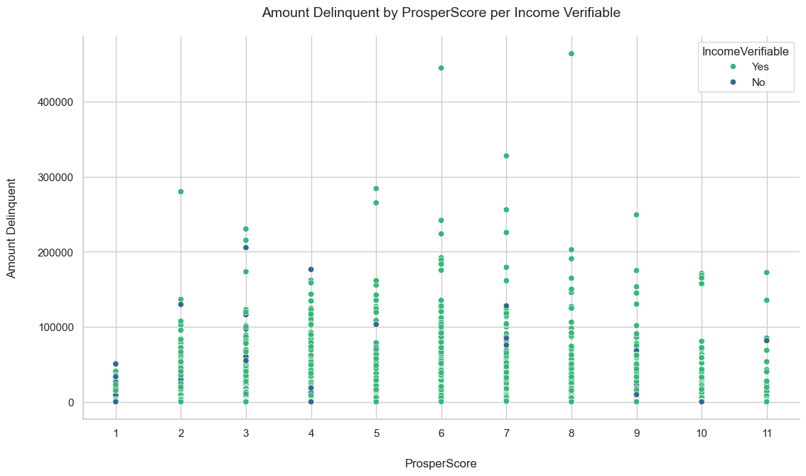
Amount Delinquent by ProsperScore per Income Verifiable
Continue to next slide for an analysis which includes this chart.

Slide 7
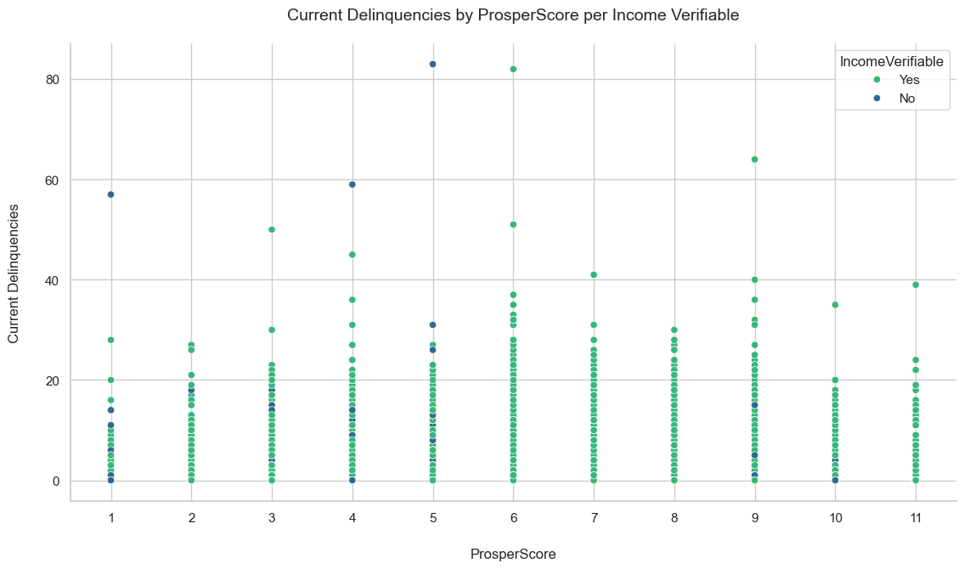
Current Delinquencies by ProsperScore per Income Verifiable
Customers with fewer current delinquencies and manageable delinquent balances tend to receive better loan conditions.
Verifying income exhibits commitment seen within the average loan borrower.
Having customers saddled with debt such as 40+ current delinquencies or 200,000 balance owed is a financial gamble. The safe play is to deny loan borrowers of this stature any new loans.

